Slide 1

Weekly Update 7
Sarang Deb Saha

Slide 2

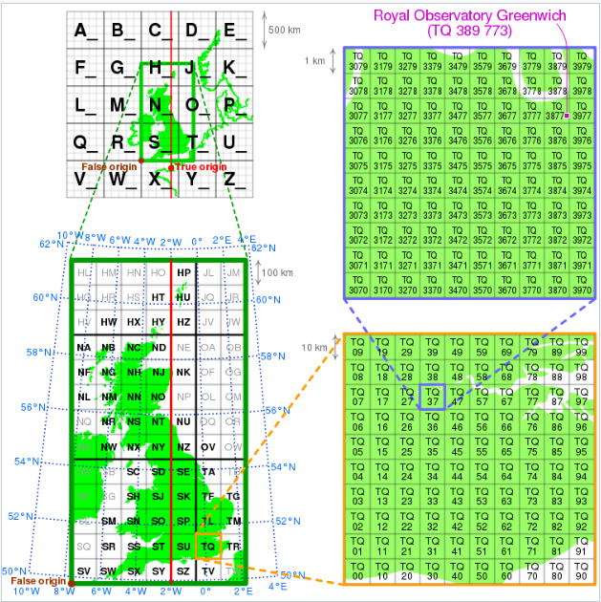
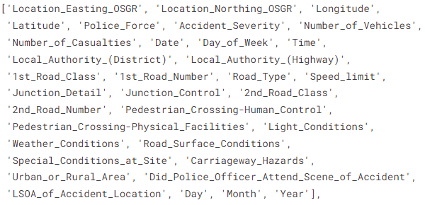
State-of-the-art Dataset:
UK Car Accidents 2005-2015
https://www.data.gov.uk/dataset/cb7ae6f0-4be6-4935-9277-47e5ce24a11f/road-safety-data
OSGR: Ordnance Survey National Grid

Slide 3
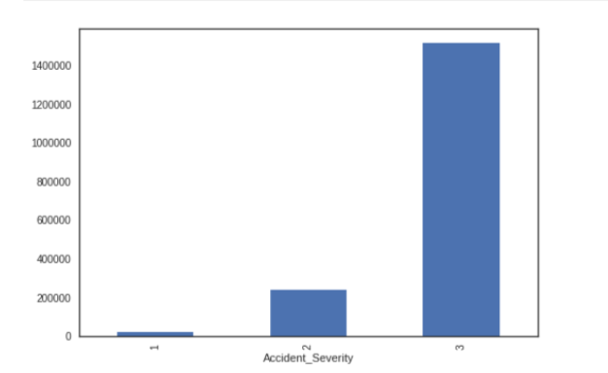
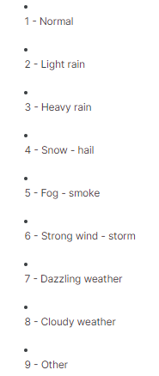
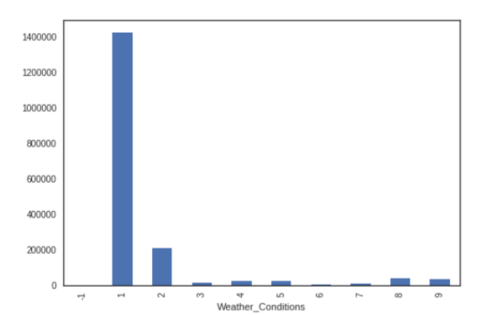
Notable insights and expectations:
1:15:75
1: Serious/Fatal Accidents
2: Mildly Serious Accidents
3: Less Serious Accidents

Slide 4
In search of reliable data in Indian context:
Scraping FIR portal
Extracting relevant data from the FIRs
Creating a dataset (.csv) with all the relevant features
Concerns regarding the website/portal security.

Slide 5
Relevant features from the FIR
PS_id && Crime No.
Circle/Sub Division
PS_name
FIR Date
Act & Section
Day of occurrence
Date of Occurrence
Time of Occurence
Place of Occurence
Distance from PS
Victim_age
Victim_gender
Vehicle_Make
Vehicle_Year
Damage_value
Violation_details
Violation_nature
Violation_cause
Severity (in case of accident)
Number of Casualties
Fatality

Slide 6
Additional features needed:
Latitude-Longitude by mapping the data
Weather at the time of incident
Type of road
Speed limit
Light Condition
Features that we might not get-
Road Surface Condition
LHS/RHS
Pedestrian_details

Slide 7
Features from Intersection violation data from IUDX:
EventID
AlertType
AlertName
Driver On Call
Green Light
License Plate Recognition
No Helmet
No Seat Belt
Over Speed
Red Light
Red Light Violation Detection
Stop Line Violation
Women Surrounded by men
channelid
channelname
Eventlocation
eventtime
message
latitude
longitude
numberplate
speedlimit
speeddetected
vehicleColor
junctionName
category

Slide 8
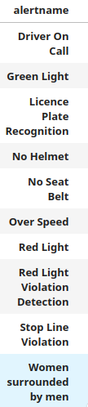
Using the ‘getallevents.py’ script for intersection violation data
Trend Analysis: Analyze the frequency of road accidents and violations over time (e.g., monthly, quarterly, yearly) to identify any patterns or trends.
Spatial Analysis: Explore the geographical distribution of accidents and violations using latitude-longitude coordinates to identify high-risk areas or intersections.
Demographic Analysis: Examine the demographics of victims, such as age and gender, to understand who is most affected by accidents and violations.
Vehicle Analysis: Investigate the types of vehicles involved, vehicle make, and year to identify any trends or patterns related to specific vehicle models.
Severity Analysis: Assess the severity of accidents based on damage value, number of casualties, and fatalities to understand the impact of accidents on individuals and infrastructure.
Temporal Analysis: Analyze the day of the week, time of occurrence, and weather conditions to identify when and under what conditions accidents are most likely to occur.
Correlation Analysis: Explore correlations between different variables (e.g., weather conditions and accident severity) to identify potential causal relationships.
FIR Response time: Analyze the time between the accident

Slide 9
Additional features for a limited dataset-
CycleTime from Red and Green light alerts or Video data
Weather factors
Temperature
Rainfall
Humidity
Wind Speed
OpenWeather API

Slide 10
Abstract (potential):
Road safety remains a critical concern in urban areas, with junctions often serving as hotspots for various traffic violations. This study presents a comprehensive analysis of road violence and detection events occurring at different road junctions in Bengaluru. Leveraging a robust system, we collected data on instances of red light violations, stop line violations, and other traffic infractions. Through meticulous analysis, we identify key factors contributing to these violations, including time of day, weather conditions, junction characteristics, and cycle length. Our findings reveal distinct patterns and correlations between these factors and the prevalence of violations.
Furthermore, we develop a predictive model utilizing machine learning techniques to forecast the likelihood of road violations at specific junctions and also predict the type of violation likely to occur. By training our model on historical event data, we demonstrate its efficacy in anticipating potential infractions with high accuracy. This predictive capability not only enables proactive intervention by law enforcement agencies but also facilitates the implementation of targeted strategies for improving road safety and reducing traffic incidents.
Overall, this study contributes valuable insights into the dynamics of road violations at junctions in Bengaluru and offers a practical framework for enhancing traffic management and safety measures in urban environments. By harnessing data-driven approaches, we aim to mitigate the risks associated with reckless driving behaviors, ultimately fostering safer and more sustainable transportation systems.

